Slide 1
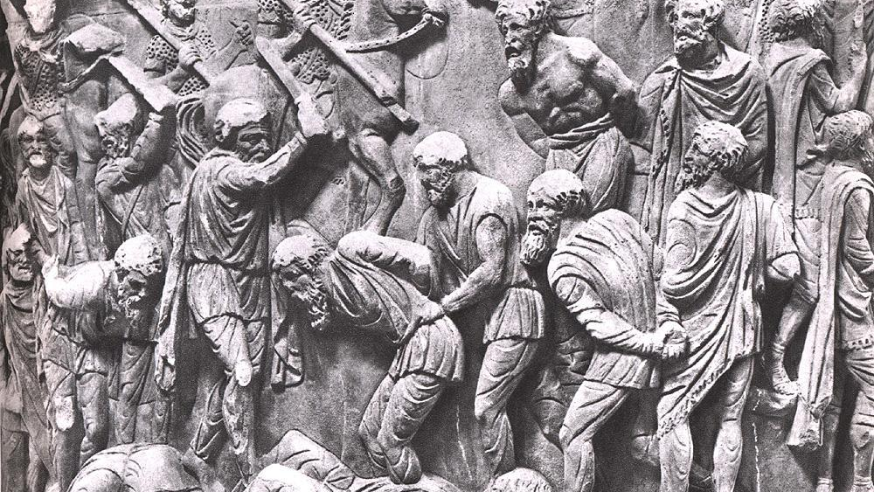
CLAS 301B The Literature of the Ancient Romans Spring 2025

Slide 2
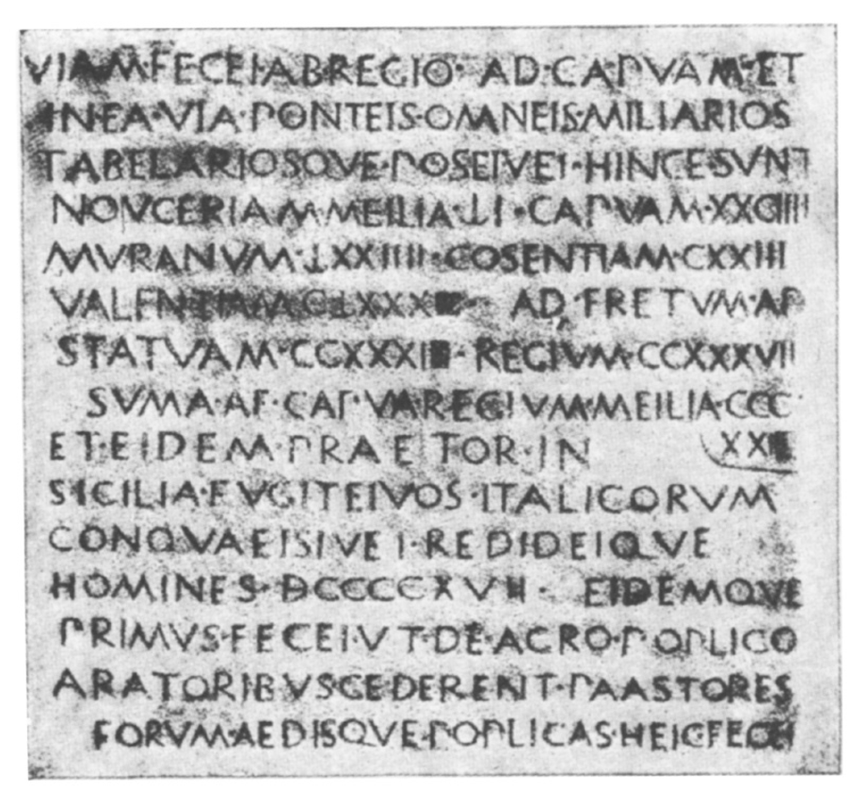
Early Roman Writing (7th century BCE)
pre-literary literacy; oratory in public life; early contacts with Greeks in South Italy
laws, religious prohibitions & hymns, public records, calendars, treaties, inscribed artifacts, epitaphs & other monuments

Slide 3
The Twelve Tables (ca. 450 BCE)
Tabula IV.2 (paternal power)
si pater filium ter venumduit, filius a patre liber esto, “If a father puts his son up for sale three times, the son shall be free from his father.”
Tabula VII.8b (land rights)
si arbor ex vicini fundo vento inclinata in tuum fundum sit, de adimenda ea . . . agere potes, “If a tree from a neighbor’s farm should be bent over to your farm by the wind, you can take action for removing it.”
Tabula VIII.1a (injury law)
si quis occentavisset sive carmen condidisset, quod infamiam faceret flagitiumve alteri . . ., “If someone has sung or composed a carmen [a magical spell?] that caused discredit or disgrace to another . . .” [capital punishment is prescribed]
Tabula VIII.12 (injury law)
si nox furtum factum sit, si im occisit, iure caesus esto, “If theft should be committed at night, and if someone kills him [i.e. the thief], he shall be killed lawfully.”
Tabula X.1 (sacred law)
hominem mortuum in urbe ne sepelito neve urito, “No one shall bury nor burn a dead person in the city.”

Slide 4
carmen/carmina (cf. cano, “sing”): describes songs (love songs, lullabies, songs at banquets & funerals), drama, magic & curses, prayers (repeated stylistic features, e.g. alliteration) (early association with literary primitivism (v. Greek poema), but later “poem”)

Slide 5
Carmen Arvale: fertility hymn to Dea Dia (”Bright Goddess”) sung by Arval brothers (Old Latin, 4th century BCE?)
enos Lases iuvate (“Help us, Lares”)
enos Lases iuvate
enos Lases iuvate
neve luem ruem Marmar sins incurrere in pleores (“Mars, don’t allow disease and disaster to attack the people”)
neve luem ruem Marmar sins incurrere in pleoris
neve luem ruem Marmar sins incurrere in pleoris
satur fu, fere Mars, limen sali, sta berber (“be satisfied, fierce Mars, leap over the threshold, stand (?)”)
satur fu, fere Mars, limen sali, sta berber
satur fu, fere Mars, limen sali, sta berber . . . (two more stanzas follow)

Slide 6
Latin Literature (240 BCE) – what took them so long?
Roman elite self-representation: pragmatic citizen-soldier-farmer too "busy" for literature (cf. negotium/otium)
Punic Wars between Rome and Carthage (1st 264-241 BCE; 2nd 218-201 BCE; 3rd 149-146 BCE)
Latin literature: acquisition of empire & cultural capital
state support for literature: status, power & prestige in Italy & Mediterranean region, national identity
wave(s) of Hellenism; early demand for drama (Plautus, Terence)
Roman Translation Project commences!

Slide 7
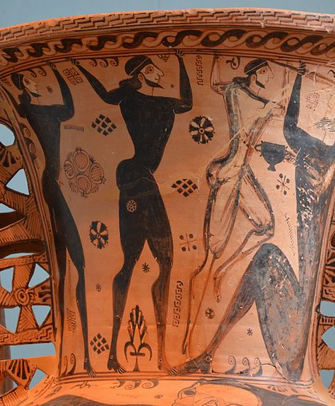
Livius Andronicus (South Italy): drama on Greek model, temporary theater @ Ludi Romani (240 BCE)
also translates Homer’s Odyssey (Ody. 1.1 ἄνδρα μοι ἔννεπε, Μοῦσα, πολύτροπον)
“Tell me, Muse, of the clever (lit. “of many turns”) man”
virum mihi, Camena, insece versutum “Tell me, Camena, of the clever man” (verto, “turn,” “transform,” “translate”) Latin literature: derivative/secondary but creative re-workings of Greek models adapted for new audiences; literary & cultural rivalry with Greeks (imitatio, aemulatio); Latin writers increasingly confident
Graecia capta ferum victorem cepit, “captured Greece captivated her savage conqueror,” Horace, Epistles 2.1.156)

Slide 8
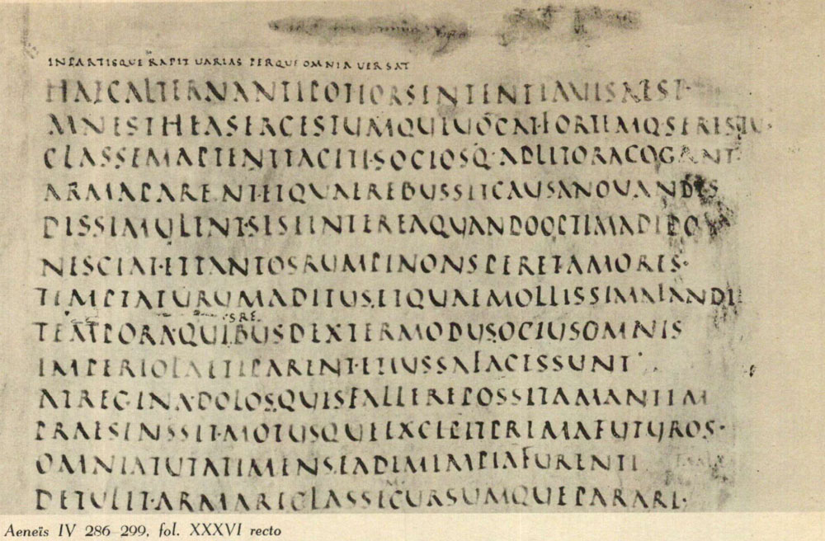
What is Latin literature & Roman literary culture?
urbanitas (“sophistication”), ”literary” Latin of highly educated (bilingual) elite
focus on male self-construction/image (militarism, masculinity; virtus, lit. “manliness”)
patria potestas (“paternal power”) & mos maiorum (“custom of ancestors”): tradition, authority, exemplarity, conformity
performative culture, competitive self-presentation in public
Others?

Slide 9
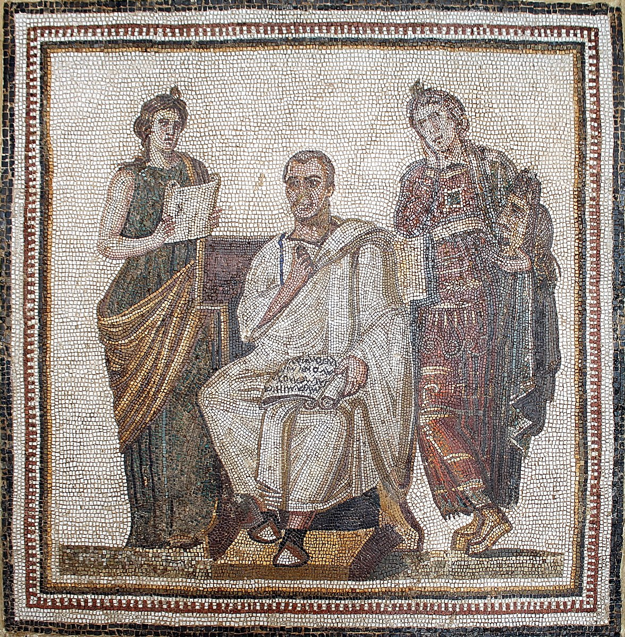
Some CLAS 301B overarching themes & tensions: literature & society private v. public life (introspection, personal identity & expression?) gender & power freedom & slavery
Some important concepts:
metaliterature/-theater/-poetics
intertextuality
reception

Slide 10
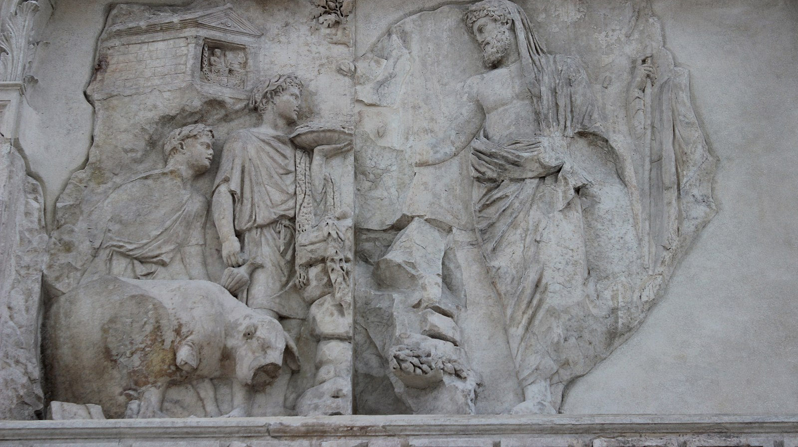
CLAS 301B – The Literature of the Ancient Romans Spring 2025 TTh 2-3:15 pm CHAVEZ 316
Course website: https://christed.faculty.arizona.edu/clas301b/home.html

