Slide 1
Clas 355
Horror, Terror, Violence & Trauma in the
Ancient Roman World
Spring 2023
Professor David Christenson
TTR 12:30-1:45PM
Chavez BLDG 301

Slide 2
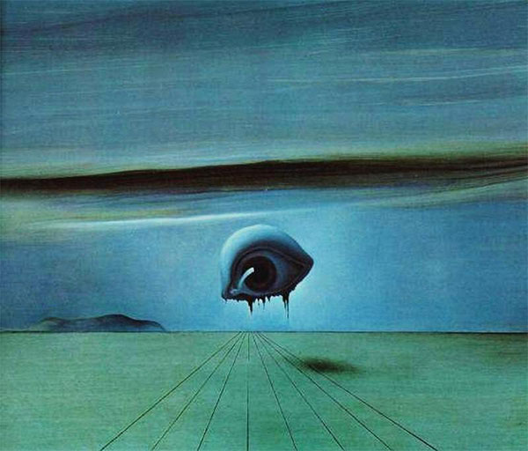
Horror, Terror, violence (Latin vis, “force”)?
Salvador Dali, The Eye (1945)

Slide 3
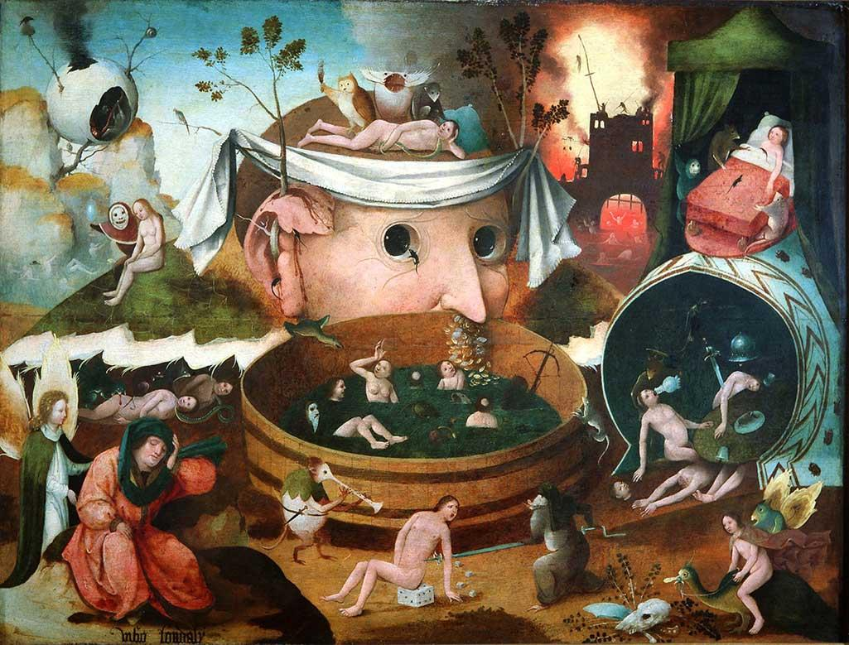
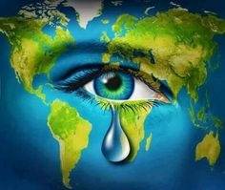
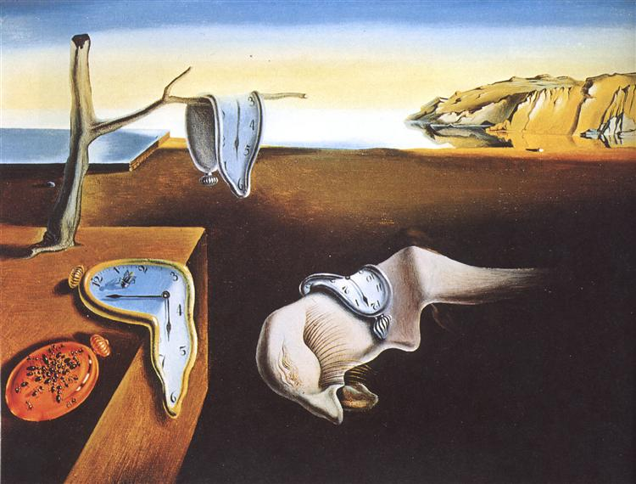
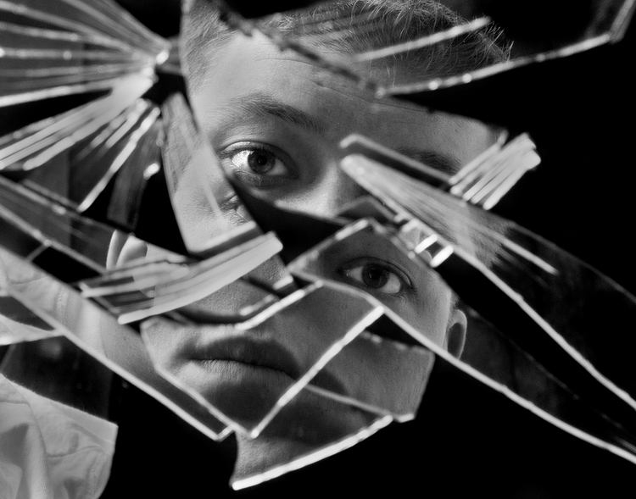
What is trauma?
(for individuals, groups, cultures?)
Greek τραῦμα: “physical wound” (“defeat,” “loss”)
PTSD in DSM-III (1980): cf. “railway spine”, “hysteria”, “shell-shock”, “war neurosis”, “combat fatigue”

Slide 4
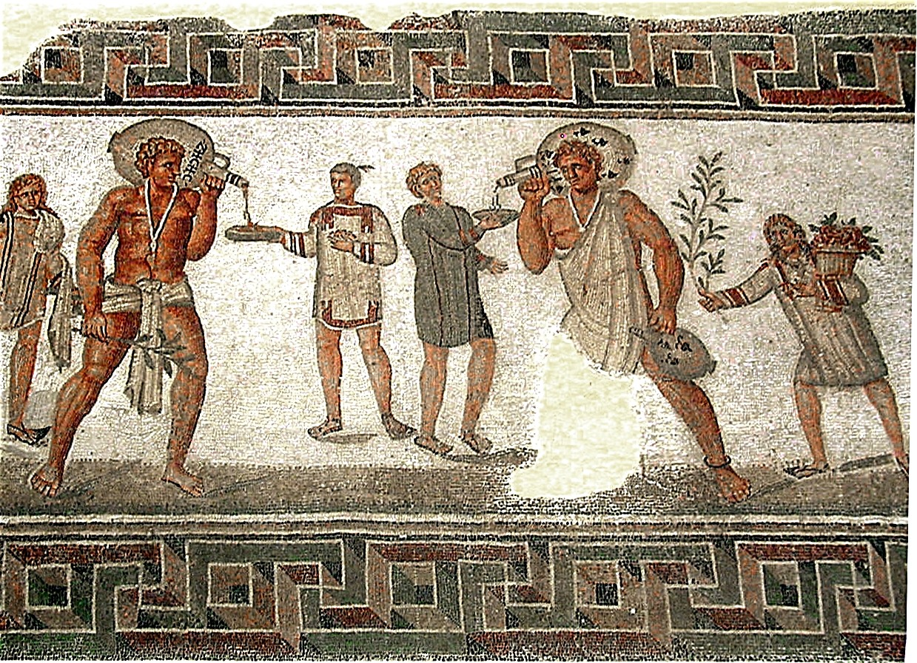
Part I. The banality of evil/Everyday HTVT-Roman Slavery (Plautus’s comedies)

Slide 5
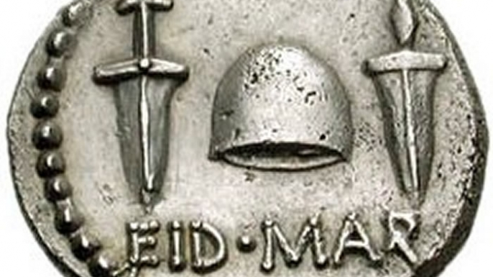
Part II. The Epic Trauma of Un-Civil War (Lucan’s Epic)

Slide 6
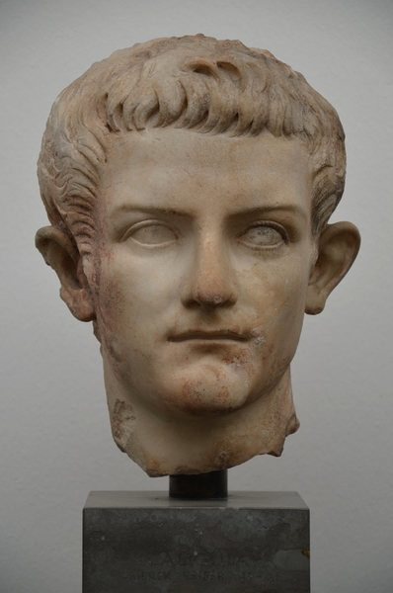
Part III. The Terror of Autocracy: Roman Emperors (Caligula, Nero)

Slide 7
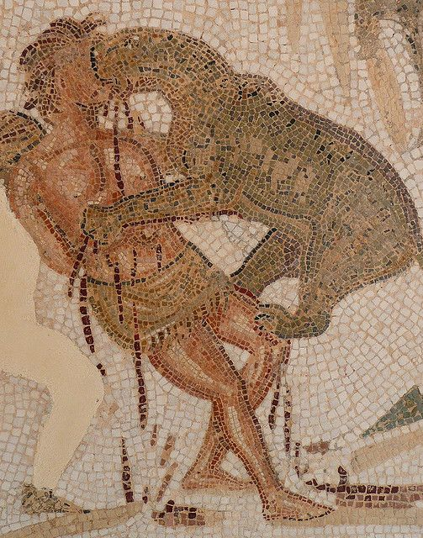
Part IV. Spectacles of Violence-Theater & Amphitheater (Seneca’s Tragedies)

Slide 8
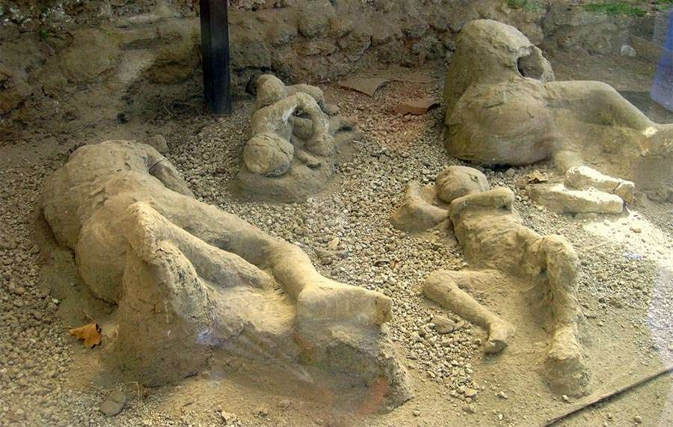
Part V. Nature’s Traumas (Earthquakes, etc.; Pompeii)

Slide 9
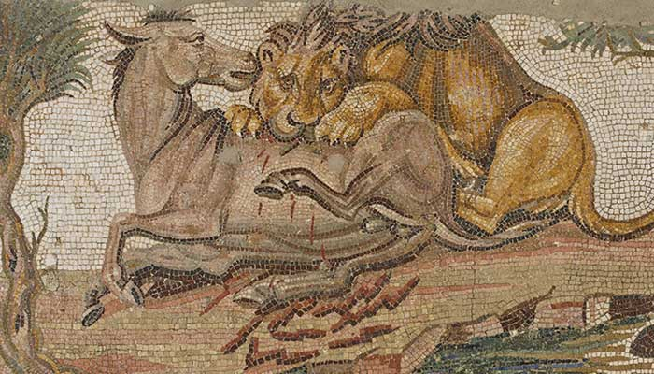
Part VI. Blurred Lines of HTVT, BeastS & HUManS (Apuleius, The Golden Ass ; Phaedrus, Fables)

Slide 10
CLAS 355
Horror, Terror, Violence & Trauma in the
Ancient Roman World spring 2023
A course in the history & literature of physical and emotional suffering
D2L: https://d2l.arizona.edu/d2l/loginh/
Course Website: http://www.u.arizona.edu/~christed/clas355/home.html

