Slide 1
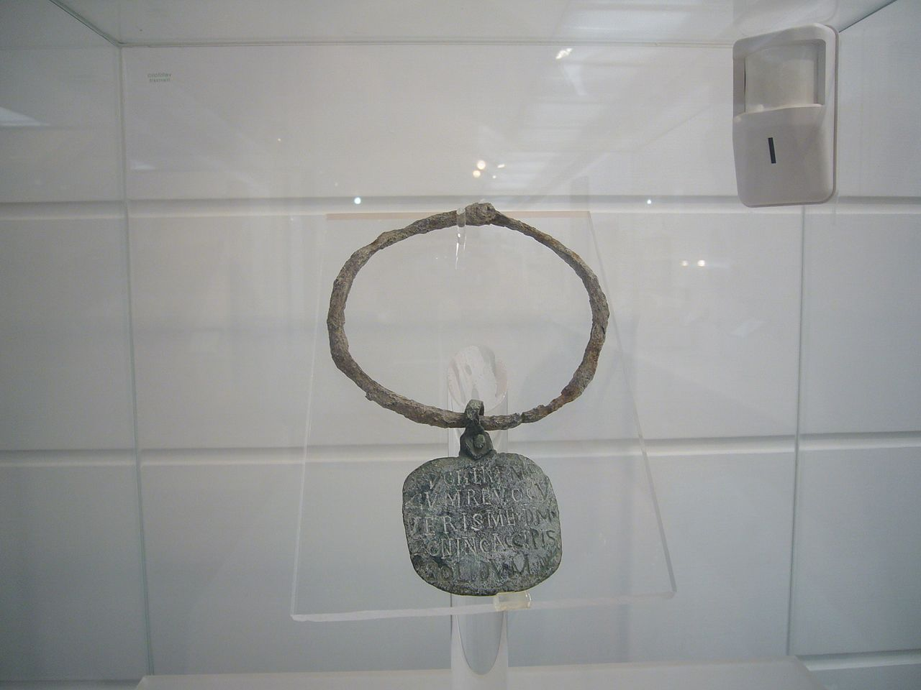
CLAS 357 – Slavery & Freedom in Ancient Rome Spring 2024 MW 11:00am-12:15pm M LNG 413 Prof. David Christenson

Slide 2
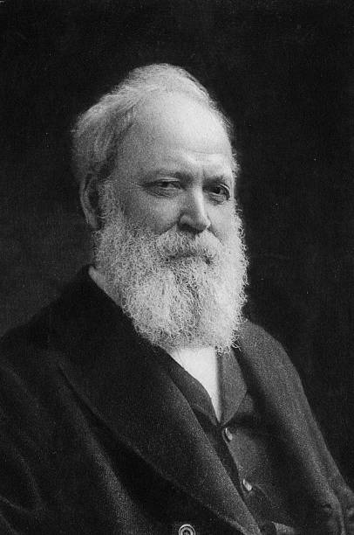
Slavery in 2023: American disavowal; reckoning (?)
“Submission to any encroachment, the least as well as the greatest, on the rights of a State means slavery. To us submission meant slavery, as it did to Pericles and the Athenians.” “That the cause we fought for and our brothers died for was the cause of civil liberty, and not the cause of human slavery, is a thesis we feel ourselves to maintain.” - Basil Gildersleeve, “father” of Classics in America (“The Creed of the Old South”, 1915)

Slide 3
What is freedom?

Slide 4
Three types of freedom: personal, sovereignal, civil (Orlando Patterson, Freedom in the Making of Western Culture, vol. I)

Slide 5
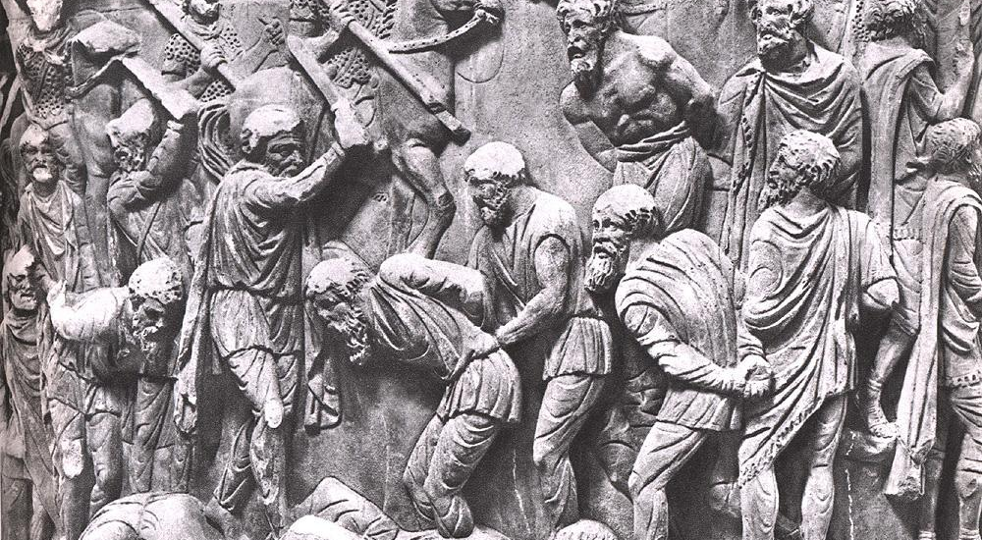
CLAS 357, Part I: Institution of Slavery in Rome – realities, ideologies, contradictions
(Joshel, Slavery in the Roman World; agricultural writers)

Slide 6
Part II: The Roman familia – paterfamilias, materfamilias, liberi, the enslaved, the manumitted (Plautus, Phaedrus, Petronius)

Slide 7
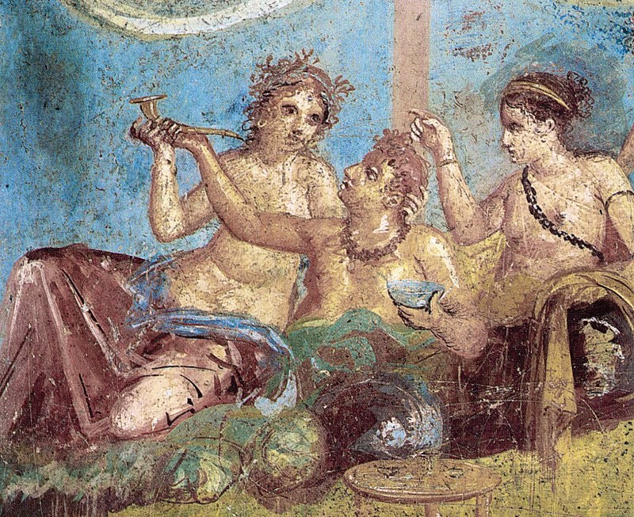
Figurative/Metaphorical Slavery Part III: Elite Male Self-Enslavement
(comic & elegiac lovers; Terence, Ovid, Propertius)

Slide 8
Part IV: Enslavement of a Nation (Augustus, Caligula, Nero; Suetonius)

Slide 9
Part V: Psychologizing, Philosophizing, and Moralizing about Freedom & Slavery (Seneca, Lucretius)

Slide 10
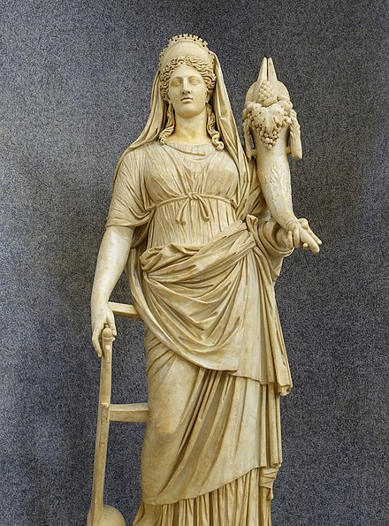
Part VI: Slavery & Freedom in Religion
(Bacchus, Isis, Christianity; Apuleius)

Slide 11
CLAS 357 – Slavery & Freedom in Ancient Rome Course website: https://christed.faculty.arizona.edu/clas357/home.html

