Slide 1
Plautus As Translator: Translation and Adaptation in Roman Comedy
By Garrett Hanson

Slide 2
Translation vs. Adaptation: On the Translation Practices of Plautus
Is Plautus merely rendering a Greek New Comedy into Latin?
Plautus vortit barbare?
Or is Plautus adapting a Greek New Comedy for a Latin audience?
If Plautus is drawing from one or more sources, how closely does he adhere to his sources; how does he differ?

Slide 3
Early Attitudes
Many early scholars of Roman comedy were unsure how to treat Plautus, whether as a close translator of Greek sources, or as an author taking extreme adaptive liberty.
The former would present Plautus as an invaluable source for lost Greek New Comedy.
The latter would highlight his creativity as an author.

Slide 4
contaminatio: A “Writing” Process
-Friedrich Leo argued for contaminatio to explain the relationship between Roman comedic authors and their Greek sources, with a special emphasis on Plautus.
- contaminatio is a process where an author combines material from multiple sources in one play.

Slide 5
Eduard Fraenkel
Fraenkel worked with newly discovered papyri of Menander in 1922, along with comparisons to Terence, to reconstruct the amount of creative liberty that Plautus took with his sources.
He found that Terence, while making small structural changes, was far closer in plot to Menander.
In contrast, Plautus was found to embellish more, in addition to structural changes.

Slide 6
Fraenkel’s Findings: Plautine Features
Amplified and Exaggerated Dialogue
Stereotypical Opening Monologue
Riddling Identification
Puns
Formal Language: legal, governmental, and religious
Military Language

Slide 7
Roman Theater and Greek Sources: Explanations for Adaptations
At least some of Plautus’ adaptations can be explained by the features of Roman and Greek theater.
Act breaks
Chorus between acts
Neither feature exists in Roman Drama.
Plautus must fill these gaps.
Cover monologues
Bridge monologues
Notes:
where a character delivers a lengthier monologue to suggest at the passing of dramatic time. This creates the illusion of passing time, and allows more liberty with possible continuity.
which is where a character directly addresses the audience, can be employed for the same function.

Slide 8
Roman Adaptation
Further, because Roman comedy often contains songs, the switch in metrical form can act in the same way as a cover or bridge monologue.
Iambic trimeter vs. Trochaic septenarii
Menander also prefers to capture the substance of an entrance, rather than manner.
Plautus instead focuses on the manner of introduction, and edits parts of Menander to switch entrances and exits for this aim.

Slide 9
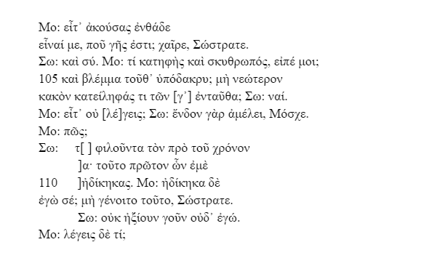
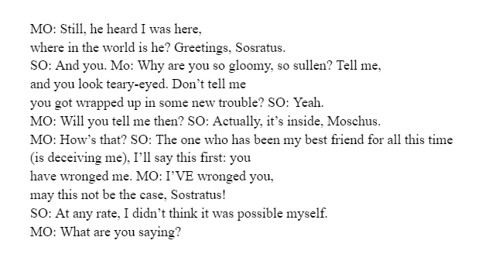
Dis Exapaton vs. Bacchides: Case #1 (Dis Exapaton 102-12)

Slide 10
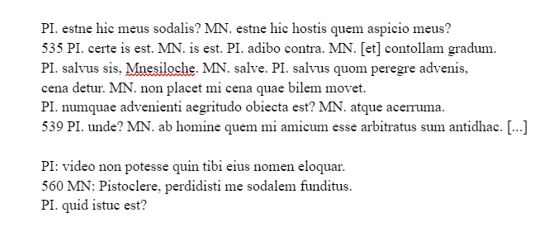
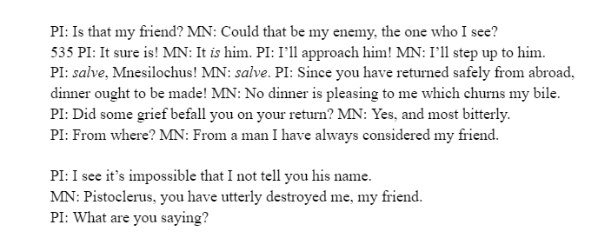
Dis Exapaton vs. Bacchides: Case #1 (Bacchides 534-9, 559-61)

Slide 11
Notes on Case Study #1
Iambic Trimeter vs. Trochaic Septenarii (catalectic tetrameter)
Musically Accompanied vs. Spoken Lines
cena adventicia is a Roman concept, absent in Menander.
Bac. 540-58 are an expansion, moralizing about friendship.
This is a purely Plautine feature
Before the discovery of the papyrus, these lines were assumed to be from Menander.
Possible contaminatio
Menander focuses on a slightly delayed encounter; not drawn out.
Plautus invokes the language of the stage, focusing on the moment; it is self-referential.

Slide 12
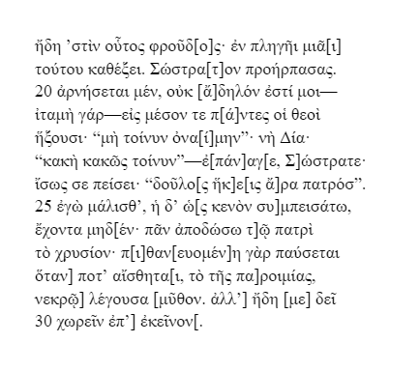
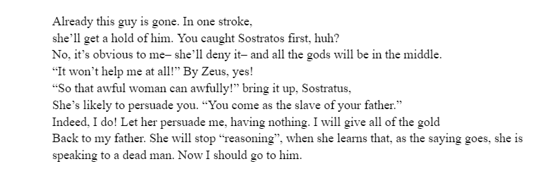
Dis Exapaton vs. Bacchides: Case #2 (Dis Exapaton, 18-30)

Slide 13
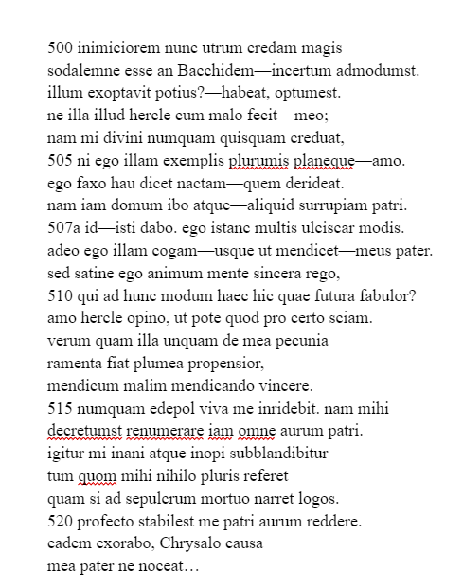
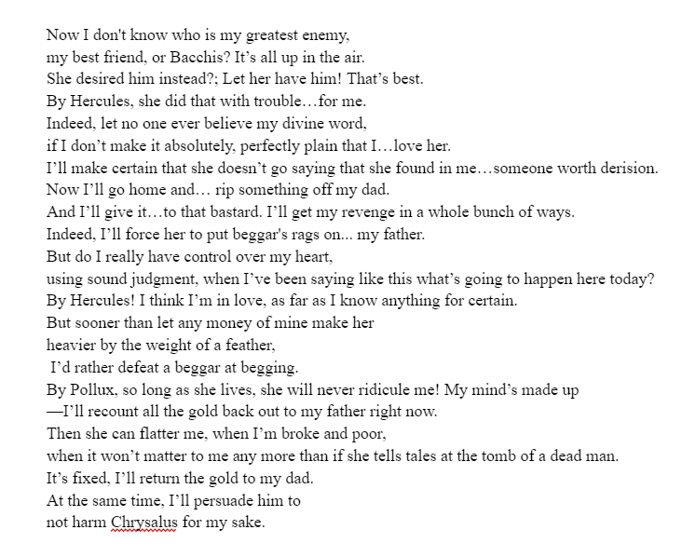
Dis Exapaton vs. Bacchides: Case #2 (Bacchides, 500-522)

Slide 14
Notes on Case Study #2
These passages show remarkable difference in their aim.
Menander focuses in on the potential of what his adulescens will say to his lover.
This broken speech within speech has the actor mimic Chrysis.
Plautus extends the soliloquy; internal battle.
His conflicting emotions create space for new jokes, paraprosdokian.
The thematic undertone is the same.
Each scene serves a different purpose in the narrative.

Slide 15
Conclusions
With all of this in mind, it is clear that Plautus is using his source material with a careful attention to his audience.
He translates Menander wholesale, when he can, but makes adaptations for the expectations of his audience.
Plautus carefully works around the missing features in his own genre.
Plautus is carefully blending New Comedy with native Italic drama to create a vibrant and creative adaptation of older works.

Slide 16
Bibliography
Bain, D. 1979. “Plautus vortit barbare: Plautus, Bacchides 526–61 and Menander, Dis exapaton 102–12.” In Creative Imitation and Latin literature, eds. D. West and T. Woodman, 17–34. Cambridge: Cambridge University Press.
Barbiero, E. A. 2016. “‘Dissing’ the Δὶς ἐξαπατῶν: Comic One-Upmanship in Plautus’ Bacchides.” Mnemosyne 69: 648-67.
Christenson, D. 2020. “Plautus: Pseudolus.” Cambridge: Cambridge University Press.
Clark, J.R., 1976. “Structure and Symmetry in the Bacchides of Plautus.” Transactions of the American Philological Association 106: 85-96.
Damen M. 1992. “Translating Scenes: Plautus’ Adaptation of Menander’s Dis exapaton.” Phoenix 46: 205–31.
Damen, M., 1995. “‘By the Gods, Boy … Stop Bothering Me! Can’t You Tell Menander from Plautus?’ or How Dis Exapaton Does not Help us Understand Bacchides.” Antichthon 29: 15-29.

Slide 17
Bibliography (cont.)
Fontaine, M. 2014. “Between Two Paradigms: Plautus.” In The Oxford Handbook of Greek and Roman Comedy, eds. M. Fontaine and A. Scafuro, 516-37. Oxford: Oxford University Press.
Goldberg, S. 1990. “Act to Action in Plautus’ Bacchides.” Classical Philology 85: 191–201.
Lloyd, R.B., 1963. “Two Prologues: Menander and Plautus.” The American Journal of Philology, 84: 146-61.
Maurice, L., 2013. “‘Contaminatio’ and Adaptation: The Modern Reception of Ancient Drama as an Aid to Understanding Roman Comedy.” Bulletin of the Institute of Classical Studies, Supplement: 445-65.
Owens, W.M., 1994. “The Third Deception in Bacchides: Fides and Plautus' Originality.” The American Journal of Philology 115: 381-407.

