Slide 1
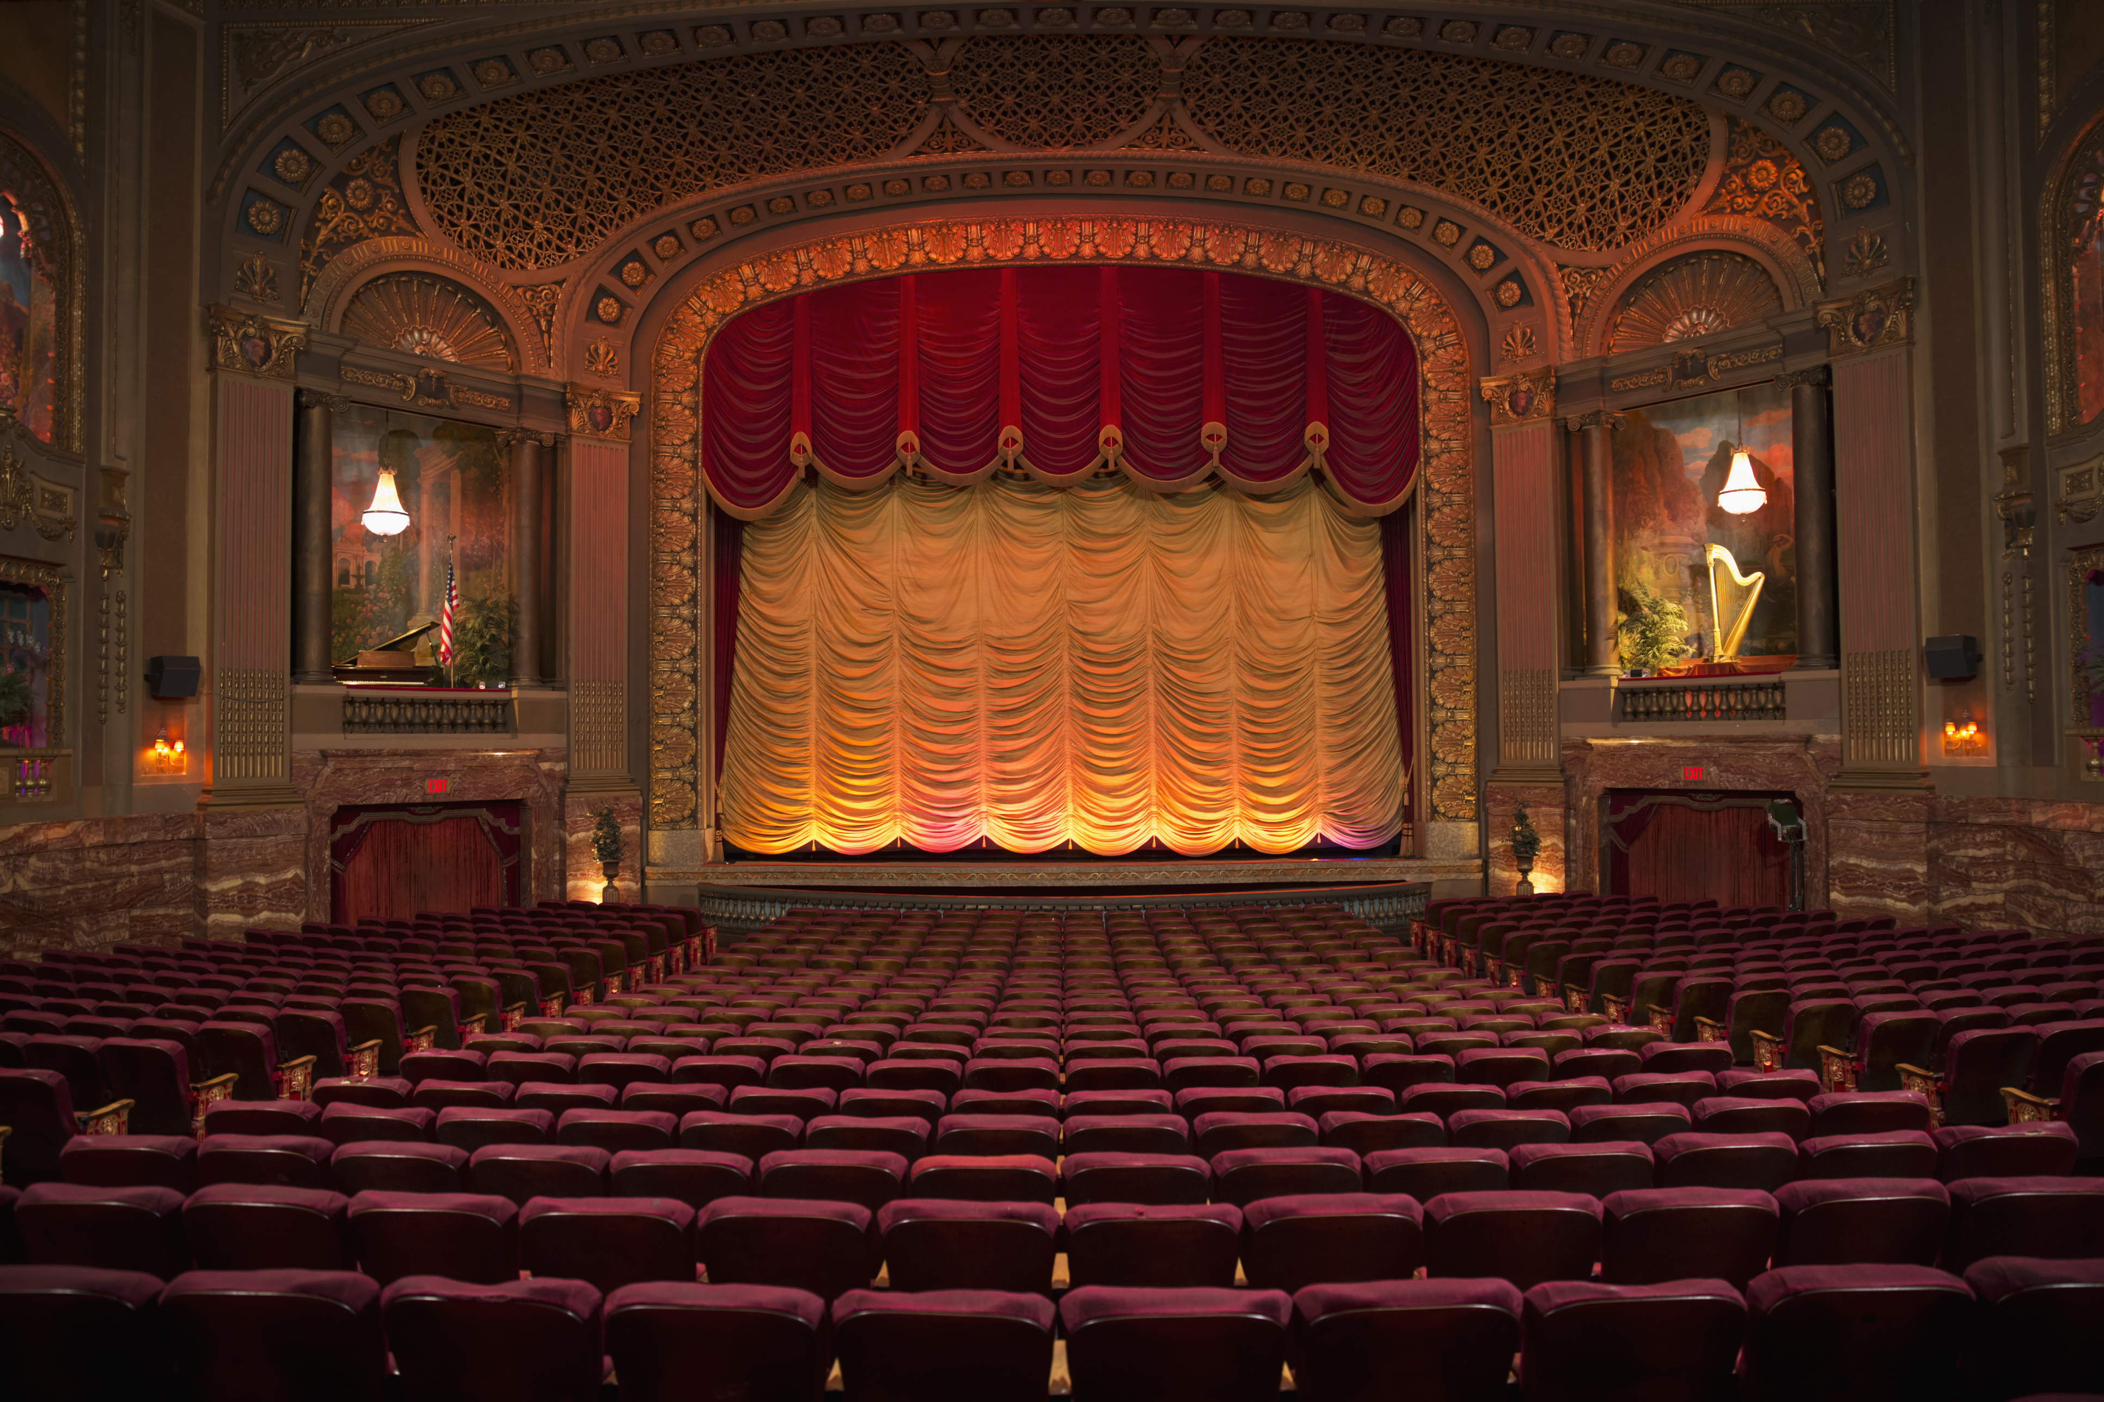
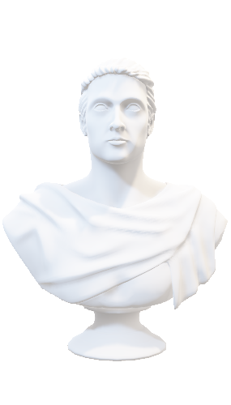
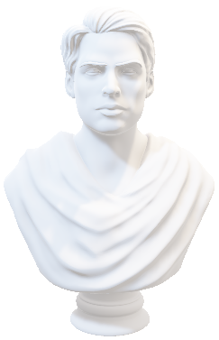
Humor in Terence
By: Christopher Lee

Slide 2
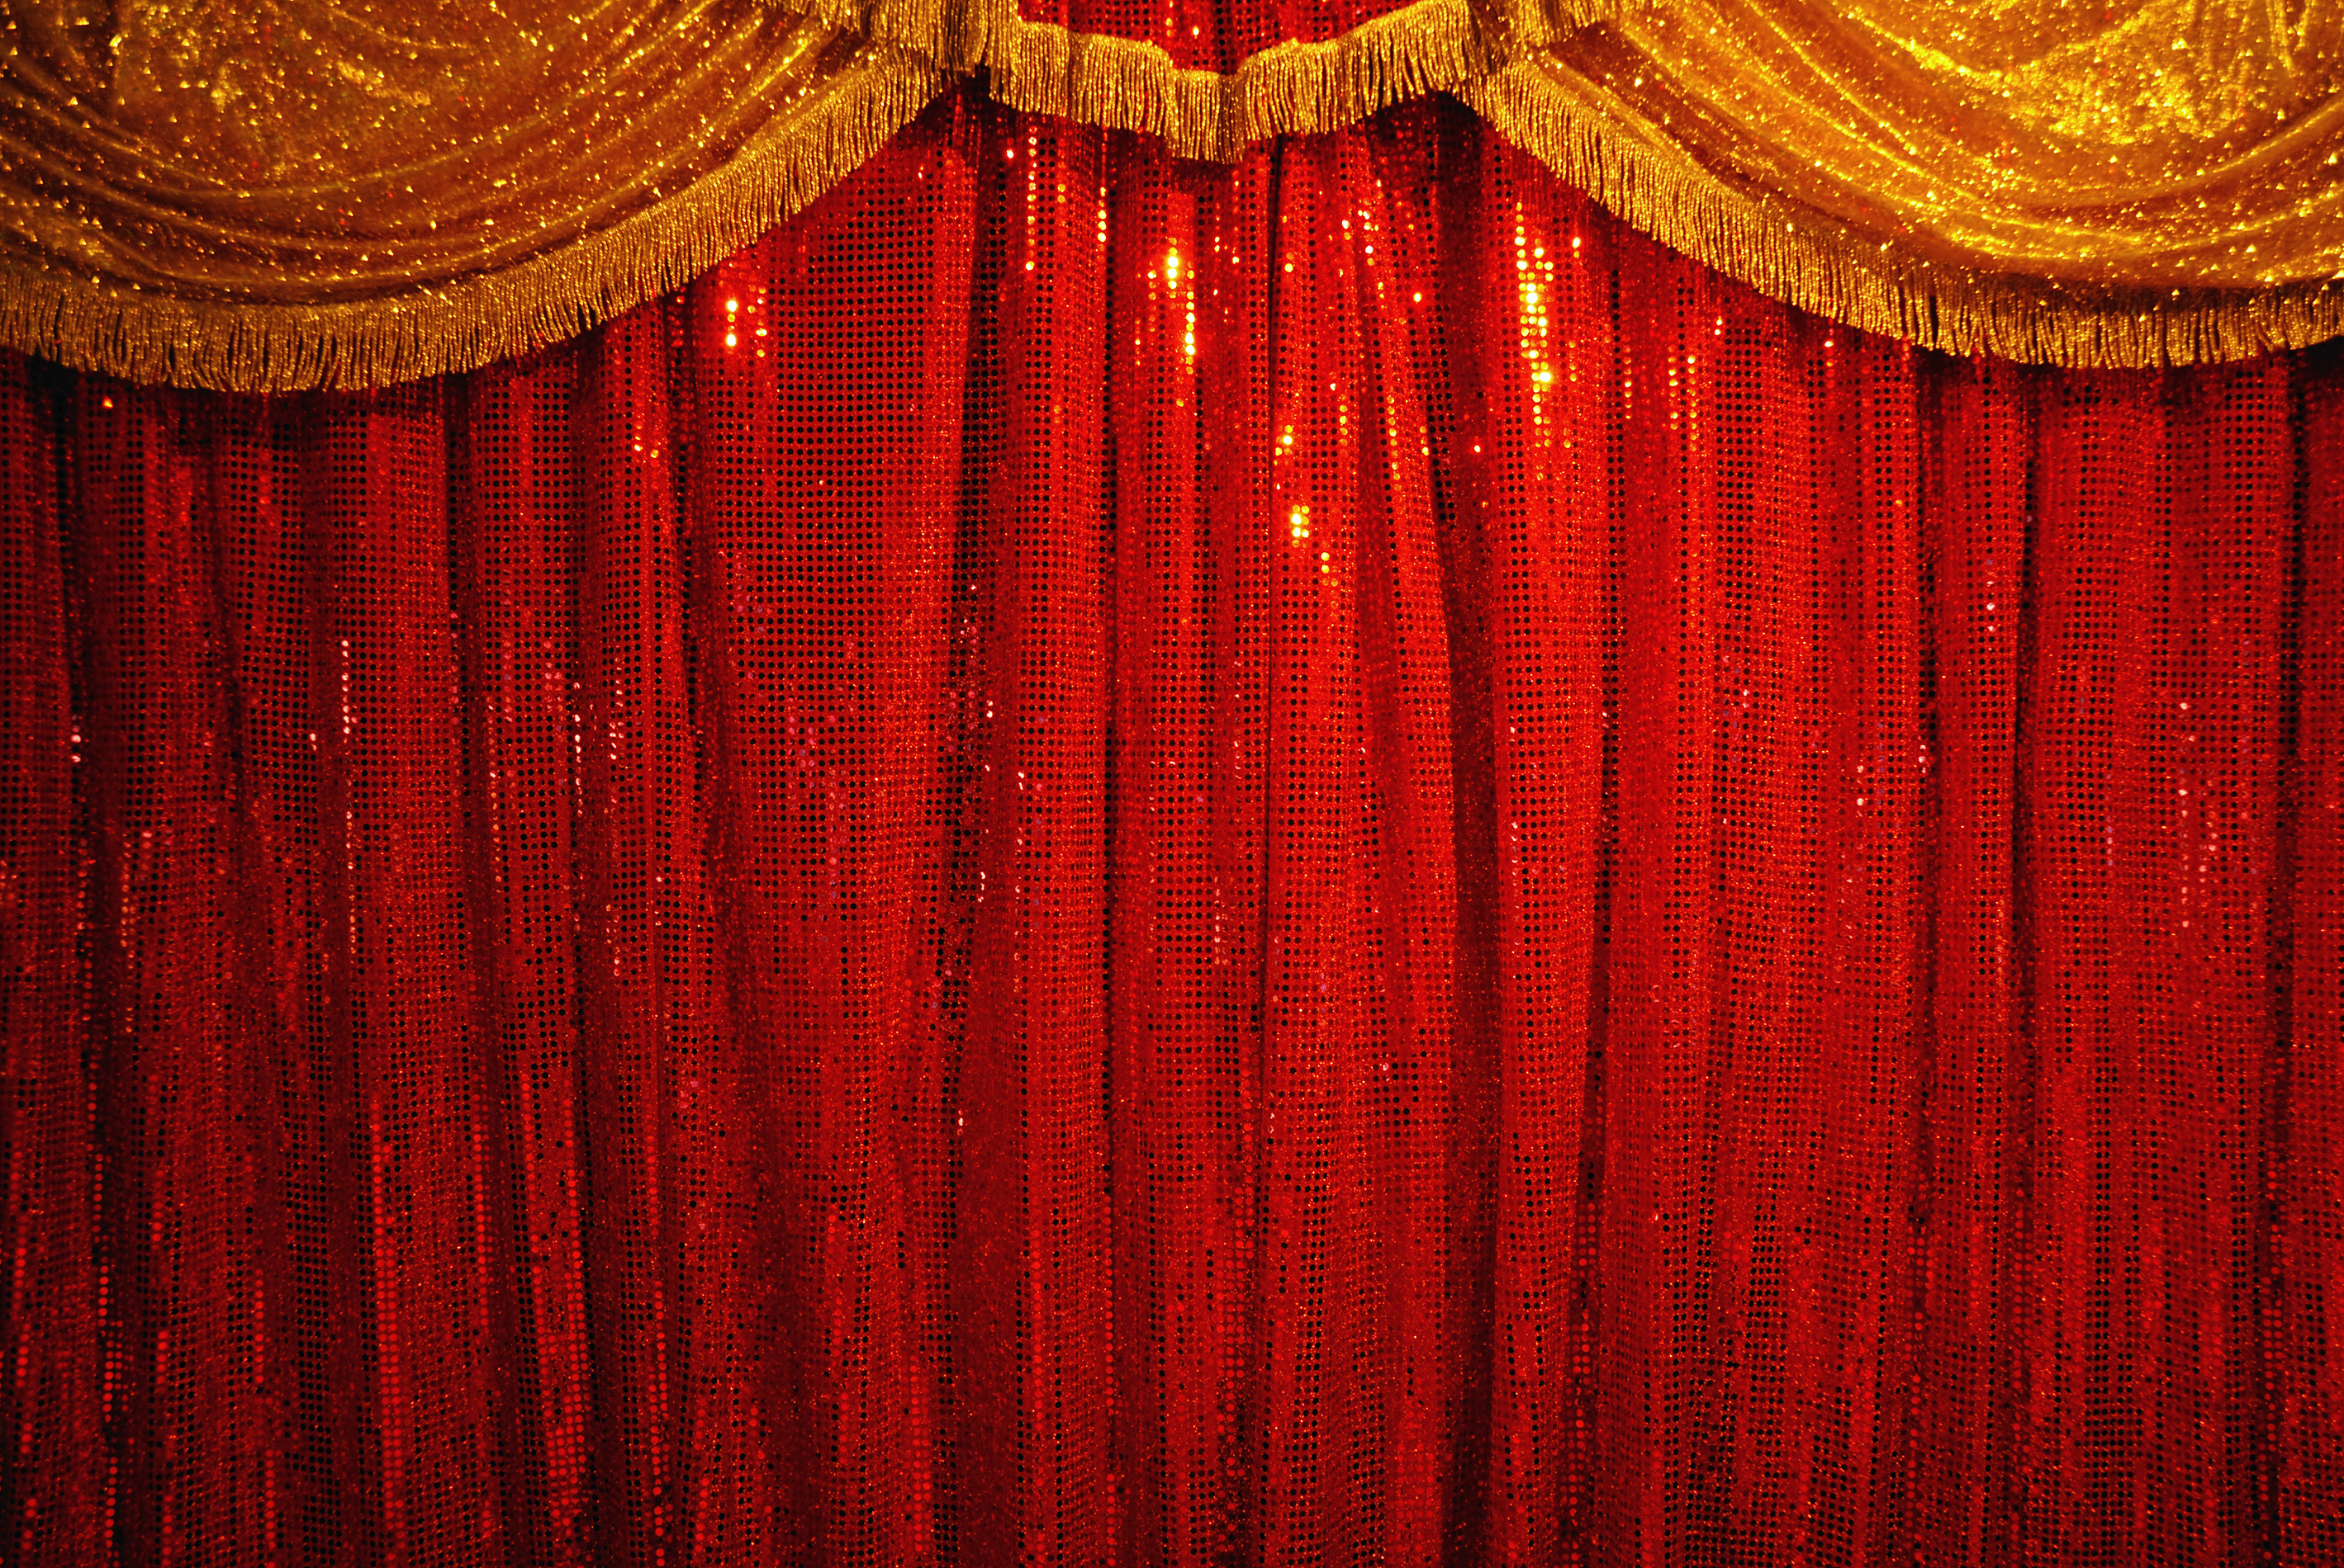

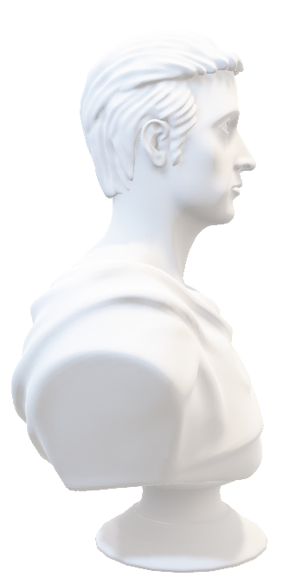
Is He Funny?
Plautus:
Odd personification
Antithetical sequences of diminutives and superlatives
Neologisms
Pleonastic frequentatives
Word-play
Terence:
“Terence is recognized for his elegant style, for his ars, and for his skill in characterization, on the subject of Terence’s humor, we find little.” (Vincent 2013, 70)
“Verbal humor of the Plautine type is extremely rare in Terence; the characters of his plays, even the slaves, were too seriously engaged in the dramatic problems … to have time to indulge in jesting and pleasantries” (Duckworth 1952, 356).

Slide 3
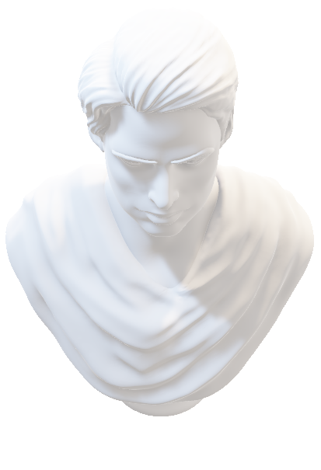
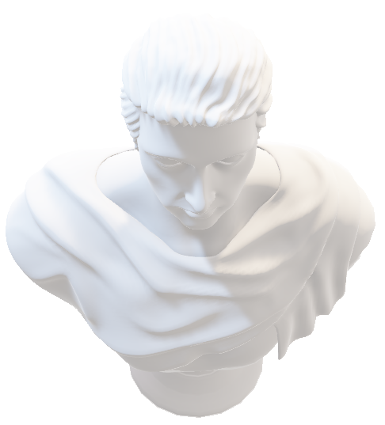
Is He Funny?
Tu quoque, tu in summis, o dimidiate Menander, Poneris, et merito, puri sermonis amator. Lenibus atque utinam scriptis adiuncta foret vis, Comica ut aequato virtus polleret honore Cum Graecis neve​ hac despectus parte iaceres! Unum hoc maceror ac doleo tibi desse, Terenti.
Julius Caesar, quoted by Suetonius (Vita Terenti)
“And you too are placed amongst the greatest, O half-Menander,
And deservedly, a lover of pure language.
But would that your gentle verses had force as well,
So that your comic virtue might have equal honor
With the Greeks, so that you might not be scorned and neglected on this point!
It hurts and pains me that you are missing this one quality, Terence.”

Slide 4
Sound and Semantics
Iterative Phonetics:
R and M repetition
nil est quod malim quam illam totam familiam dari mi obviam, /ut ego iram hanc in eos evomam omnem (Adelphoe 311-12)
Terminal Alliteration
animam primum exstinguerem and tum autem Syrum inpulsorem (Adelphoe 314-15)
Iterative near-repetition
Segmentation Pun:
si exstillaveris v. sex stillaveris (Phormio 975)

Slide 5
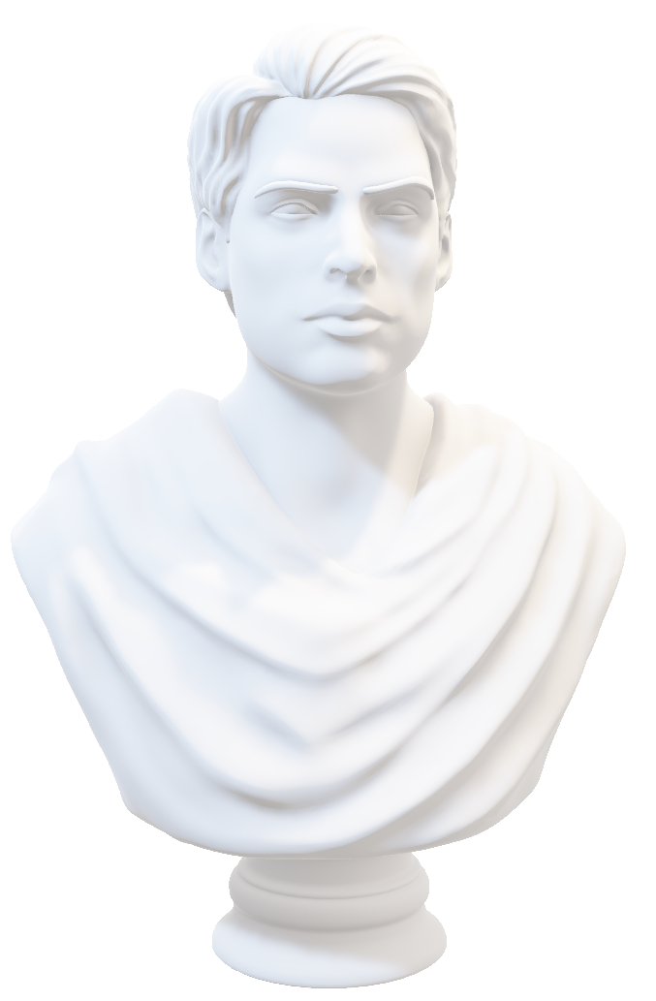
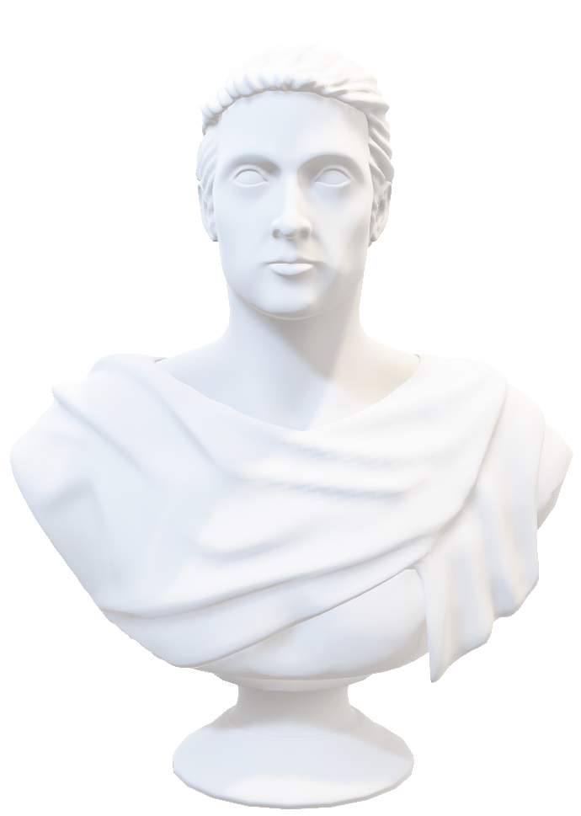
Double Entendre
Eunuchus 317–18
nova figura oris
color verus
corpus solidum
Sexual undertones
suci plenum
σῦκον – fig
Bilingual humor

Slide 6
Parody
o Demea, / istuc est sapere, non quod ante pedes modost / videre sed etiam illa quae futura sunt / prospicere! (Ad. 385-8)
quod est ante pedes, nemo spectat, caeli scrutantur plagas (Cic. Div. 2.13.1) “what is at one’s feet, no one sees, but they peer intently at the regions of the sky”
Subversion of stock roles:
Hecyra
Adelphoe

Slide 7



Physical Humor
Sed haec omnia perinde sunt, ut aguntur. Actio, inquam, in dicendo una dominatur. Cicero, De Oratore 213
“ But all these parts of oratory are just as they are delivered. Acting, I say, has the sole dominion in speaking”
Servus currens stock scene
Lengthy entrance monologue
Overly enthusiastic threats
Exaggerated self-importance
Hasty, breathless, disorderly, cloaked

Slide 8
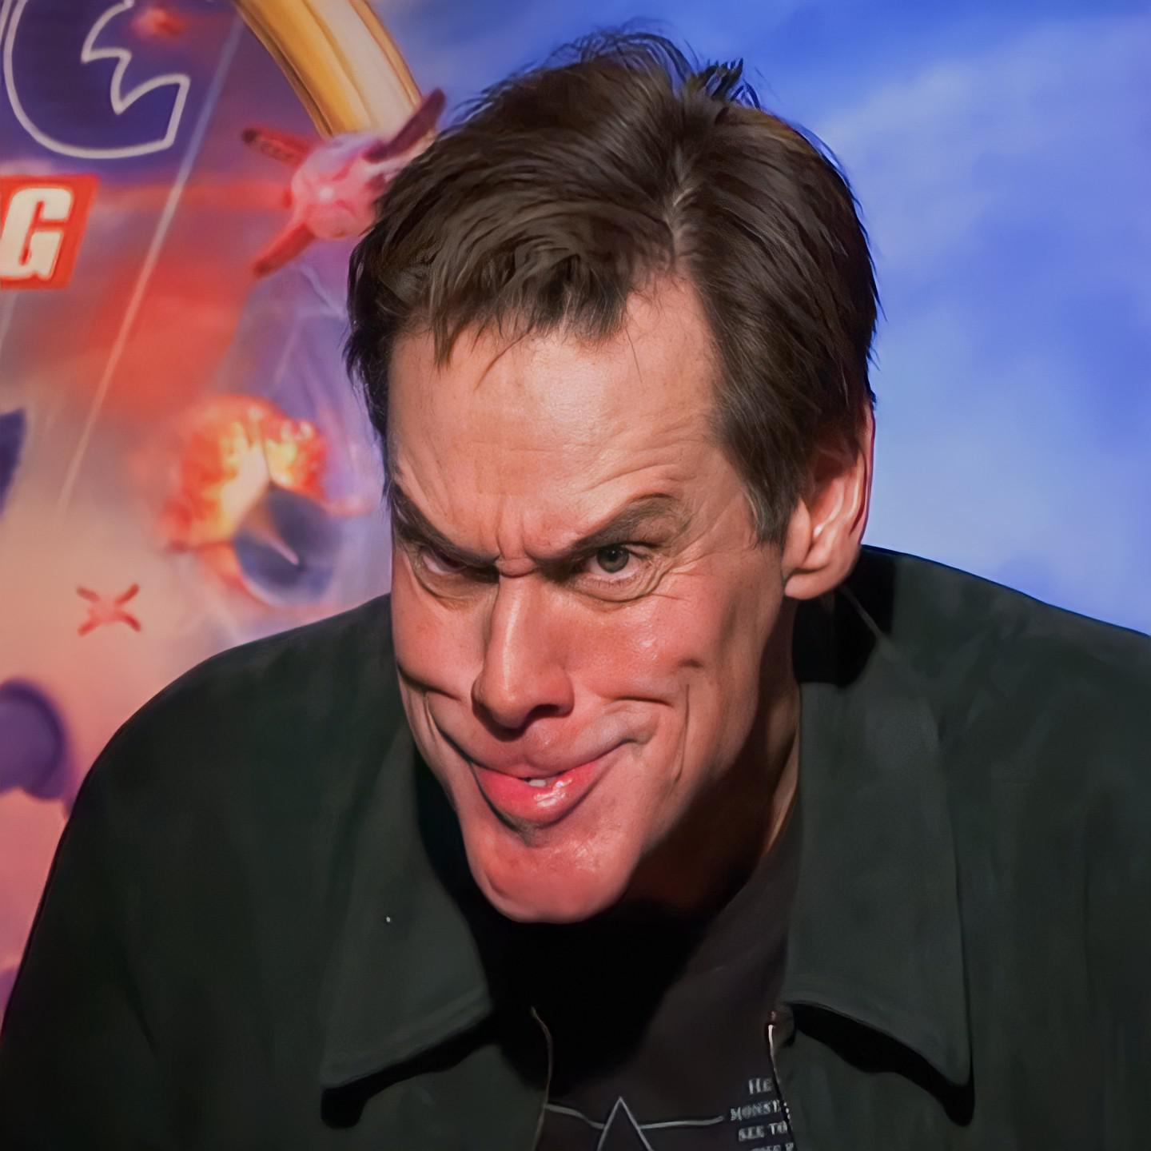


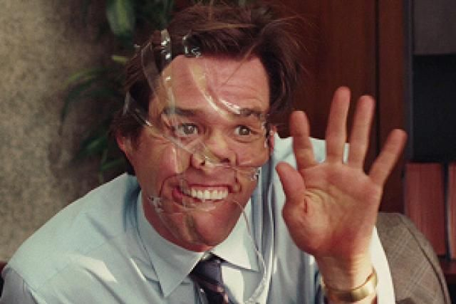
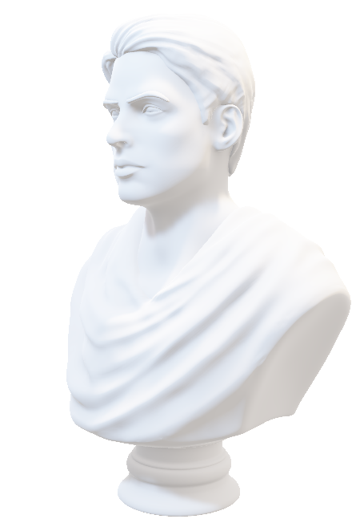
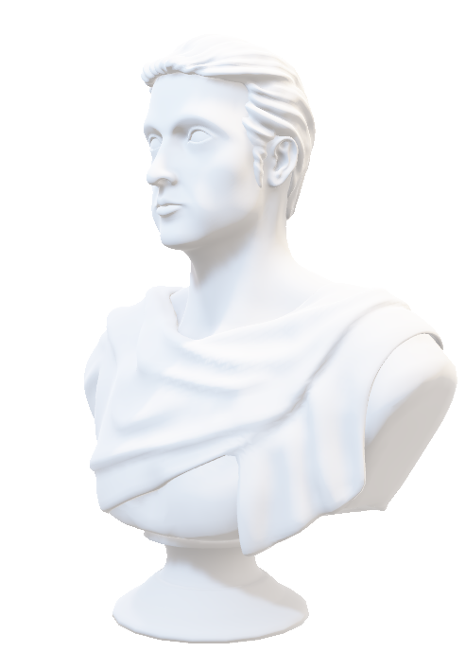
Physical Humor
Ant: obsecro, quid si assimulo? satinest?
“I beg you, what if I pretend? Would that do?”
Get: garris.
“You’re joking.”
Ant: voltum contemplamini. em, / satine sic est?
“Look at my expression. Em, is this all right?”
Get: non. “NO.”
Ant: quid si sic? “What about this?”
Get: propemodum. “Nearly.”
Ant: quid sic? “Or this?”
Get: sat est: / em, istuc serva.
“Very well, em, keep that one”
Phormio 210-13
Pho: nunc gestus mihi uoltusque est capiundus nouos
(Phormio 890)
“Now I must get new gestures and a new face”
Metatheatrical?
Use of Masks?

Slide 9

Knockabout Scenes
primum aedis expugnabo. (773)
virginem eripiam. (773)
Thr: in medium huc agmen cum vecti, Donax; / tu, Simalio, in sinistrum cornum; tu, Syrisce, in dexterum. / cedo alios. ubi centuriost Sanga et manipulus furum?
San: eccum adest. /
Thr: quid, ignave? peniculon pugnare, qui istum huc portes, cogitas? (774-9)
Thr: “Get in the center of the line here with your crowbar, Donax; you, Simalio, get on the left wing. You, Syriscus, on the right wing. Bring on the others. Where is the centurion Sanga and his company of thieves?”
San: “I am present.”
Thr: “What, you knave? Are you thinking to fight with that sponge, which you carry with you here?”
nebulo magnus (785)
Eunuchus (771–816)
Sannio –
iniuriam (162)
ius (164)
iusiurandum (165)
iniuria (166)
Aeschinus –
ne mora sit, si innuerim, quin pugnus continuo in mala haereat (171)
Adelphoe (155–96)

Slide 10
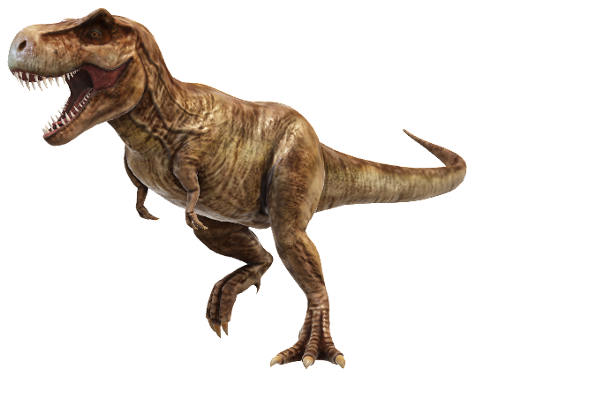
Bibliography
Anderson, W. S. 1995. “The Roman Transformation of Greek Domestic Comedy.” The Classical World 88: 171–80. Cairns, D., ed. 2005. Body Language in the Greek and Roman Worlds. Swansea: Classical Press of Wales. Cardoso, I. T. 2019. “Comic Technique.” In The Cambridge Companion to Roman Comedy, ed. M. T. Dinter, 120-35. Cambridge: Cambridge University Press. Duckworth, G. E. 1952. The Nature of Roman Comedy. Princeton: Princeton University Press. Ehrman, Radd K. 1985. “Terentian Prologues and the Parabases of Old Comedy.” Latomus 44, 370–6. Goldberg, S. M. 1982. “Terence and the Death of Comedy.” Comparative Drama 16: 312-24. Knorr, O. 2007. “Metatheatrical Humor in the Comedies of Terence.” In Terentius Poeta, eds. P. Kruschwitz, W. Ehlers, and F. Felgentreu, 141-8. Munich: C. H. Beck Verlag. Lowe, J. C. B. 2009. “Terence and the Running-Slave Routine.” Rheinisches Museum fūr Philologie 152: 225-34. Rand, E. K. 1932 “The Art of Terence’s Eunuchus.” Transactions and Proceedings of the American Philological Association 63: 54–72. Klein, S. 2015. “When Actions Speak Louder than Words: Mute Characters in Roman Comedy.” The Classical Journal 111: 53–66. Vincent, H. 2013. “Fabula Stataria: Language and Humor in Terence.” In A Companion to Terence, eds. A. Augoustakis and A. Traill, 69-88. Malden, MA: Blackwell Publishing.

