Slide 1
The Apotheosis of Trimalchio Compared to the Julio-Claudians’
Griffin Fleischaker

Slide 2
Satyricon 29.3-6
Erat autem venalicium cum titulis pictum, et ipse Trimalchio capillatus caduceum tenebat Minervaque ducente Romam intrabat. Hinc quemadmodum ratiocinari didicisset, denique dispensator factus esset, omnia diligenter curiosus pictor cum inscriptione reddiderat. In deficiente vero iam porticu levatum mento in tribunal excelsum Mercurius rapiebat. Praesto erat Fortuna cornu abundanti copiosa et tres Parcae aurea pensa torquentes.
Notes:
He was painted in the slave market with a plaque, and Trimalchio himself grasping a caduceus and Minerva leading him into Rome. Hence in that manner he had learned to reason, and was made an accountant, all carefully restored by the curious painter with an inscription. In the space where the wall gave out to the door, Mercury snatched him by the chin and raised him up on an elevated platform. Fortuna stood out with a richly overflowing horn and three Fates twisting an allotment of golden wool.

Slide 3
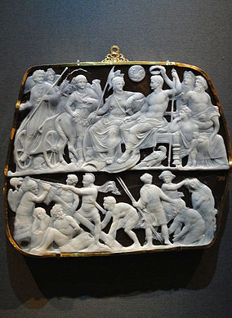
The Apotheosis of Augustus
Augustales: Imperial cult to the deified Augustus formed in the 1st century BCE
  They worshipped a deified Augustus in the provinces away from Rome during his life.
Gemma Augustea: reign of Tiberius
  Image source: Kunsthistorisches Museum, Vienna
Notes:
Augustales and the connection in the text with the fasces

Slide 4
The Apotheosis of Augustus (cont.)
Tractatum etiam in senatu an, quia condidisset imperium, Romulus vocaretur; sed sanctius et reverentius visum est nomen Augusti, ut scilicet iam tum, dum colit terras, ipso nomine et titulo consecraretur …
  Florus, Epitome Rerum Romanorum, 2.34.66
“It was also discussed in the senate if he should not be called Romulus, because he had established the empire; but the name of Augustus was deemed more holy and venerable, in order that, while he still lived on earth, he might be given a name and a title which raised him to the rank of a deity.”

Slide 5
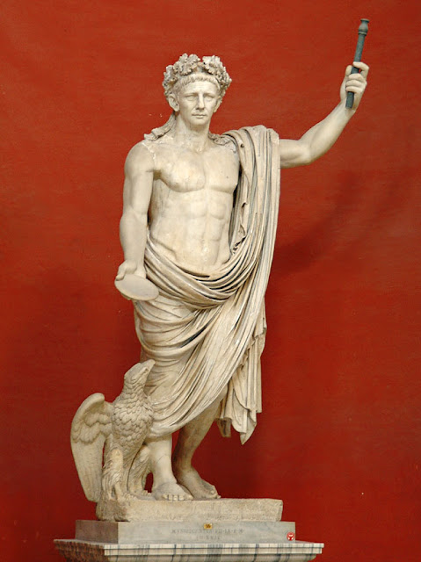
The Apotheosis of Claudius
Ad summam, tria verba cito dicat et servum me ducat. Hunc deum quis colet?
  “To sum it up, have him say three words quickly and have him lead me as a slave. Who will worship this god?”
  Seneca, Apocolocyntosis 11.3
  Trimalchio is depicted as the opposite of this
Caelestesque honores Claudio decernuntur et funeris sollemne perinde ac divo Augusto celebratur…
  “And the heavenly honors are decreed to Claudius and this solemn funeral is celebrated in the way of the divine Augustus …”
  Tacitus, Annales, 12.69
The Deification of Claudius
  Image source: The Vatican Museums, Vatican City
Notes:
‘How can you make this man a god who cannot say three words in quick succession?”

Slide 6
Bibliography
Battistella , C. 2006. “Trimalchio's 'Kidnapping': Mythological and Iconographic Memory in Petr. Sat. 29.5.” Mnemosyne 59. 427-33.
Bodel, J. 2016. “Death and Social Death in Ancient Rome.” In J. Bodel and W. Scheidel (eds.), On Human Bondage: After Slavery and Social Death (Malden, MA), 81-108.
Fishwick, D. 1992. “On the Temple of Divus ‘Augustus.” Phoenix: 232-55.
Fishwick, D. 2002. “The Deification of Claudius.” The Classical Quarterly 52: 341-9.
Hackworth Petersen, L. 2015. “’Arte Plebea and Non-elite Roman Art.” In B.A. Borg (ed.), A Companion to Roman Art (Malden, MA), 214-30.
Hübner, W. 2003. “Trimalchio Mercurialis.” In D. Accorinti and P. Chuvin (eds.), Des Géants à Dionysos: Mélanges offerts à Francis Vian (Alessandria), 75-94.
Neumann, G. 1999. “Petron, Satyrica c. 29, 5”, Würzburger Jahrbücher für die Altertumswissenschaft 23: 115-22.
Paschalis, M. 2009. “Seneca’s Apocolocyntosis and Petronius’ Satyricon.” In M. Paschalis et al. (eds.), Readers and Writers in the Ancient Novel (Groningen), 1012: 102-14.
Zanker, P. 1990. The Power of Images in the Age of Augustus. Ann Arbor: University of Michigan Press.

