Slide 1
noctis geminatis
&
corpora caesorum
Erichtho in Lucan’s Pharsalia

Slide 2
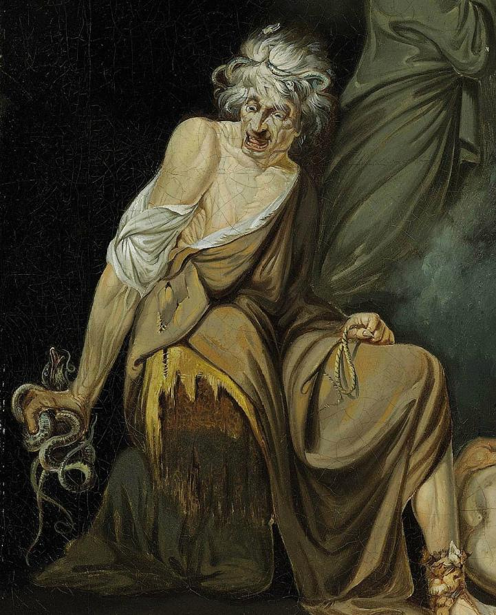
Erichtho in Pharsalia:
Erichtho as personification of civil war
Thematic parallels in the Erichtho scene
Doubles and reflections
Halves and parts
Reversals and inversions
Erichtho and metapoetic magic
Vates as poet and prophet

Slide 3
Erichtho as Personified Civil War
A “goddess” of civil war in the absence of actual divinities
6.628, Thessala → her homeland and the battlefield of Pharsalus are one and the same
6.560, ipsa facit manes → a creator of death, as war also is
“she creates shades by herself”
Etymologizing: Erichtho . . .
→ ἔρις-χθών
→ Martis tellus
→ “earth of Mars”
→ battle-field

Slide 4
Doubles and Reflections
Parallels to the double and opposed Roman forces:
6.511-2, desertaque busta / incolit et tumulos expulsis obtinet umbris
“she inhabits deserted tombs and occupies burials with the shades expelled”
Erichtho mimicking the dead with which she associates
6.517, Stygio facies pallore gravatur
“her face is burdened with Stygian pallor”
Again: Erichtho resembling the dead with which she associates
6.564, incubuit membris atque oscula figens / truncavitque caput
“she lay upon the limbs and, as she pressed kisses, severed the head”
Note erotic undertone, coupling of corpse-like figure and corpse
6.624, noctis geminatis arte tenebris
Technically has creative powers: doubler of death and darkness

Slide 5
Halves and (Body) Parts
Mangled/destroyed/dismembered bodies as destroyed Rome:
6.564, incubuit membris atque oscula figens / truncavitque caput
Severed head also foreshadows Pompey’s death
6.625-6, pererrat / corpora caesorum tumulis proiecta negatis
Dubious link with caesorum / Caesar

Slide 6
Reversals and Inversion
The power of Rome working against itself:
6.507, scelerum ritus
“wicked rites”
Religious sense of ritus contrasted with sinister magic
6.531, perversa funera pompa
“with the funeral procession being reversed”
Necromancy as a perverting and reversing act, living become dead and vice versa
6.552-3, morsusque luporum / expectat, and 6.627, continuo fugere lupi
“she waits for the biting of wolves”, and “one after another the wolves fled”
Twist on Roman nurturing wolf-figure, now scavenging corpses
6.564, incubuit membris atque oscula figens / truncavitque caput
Erotic again: here the woman is active participant and the man (being dead) is passive

Slide 7
Vates: Who’s the Real Poet Here?
Vates as both prophet and poet (a speaker with divine inspiration)
Related: carmen as both spell (6.647, carmine) and as song, metapoetics of magic
Lucan self-describes as vates (poet) at 1.63 and 7.553, here describes a vates (prophet)
6.628-9, dum Thessala vatem / eligit
The corpse-prophet foretells the outcome of the war, or, the outcome of the poem
6.651-2, quamvis Thessala vates / vim faciat fatis
The witch is also a prophet, being the one who controls the speaking corpse (cf. Apollo + Sibyl)
Where are the corpses coming from? The battle isn’t until tomorrow…
Lucan’s control over (narrative) time, over (his characters’) death, parallels the powers of Erichtho
Rather, the powers of Erichtho parallel those of the author (cf. Ovid’s Orpheus)
Erichtho’s nefarious magic resembles Lucan’s control over his poem of nefas

Slide 8
Bibliography
Celotto, G. 2018. “The Metapoetic Function of Magic: Ovid's Orpheus and Lucan's Erichtho.” Latomus 77: 628-45.
Cohen, J. J. 1996. “Monster Culture (Seven Theses).” In Monster Theory: Reading Culture. ed. J.J. Cohen, 3-25. Minneapolis: University of Minnesota Press.
Franzen, C. 2011. “The Violation of the Eye and the Theft of Vision in Lucan’s Bellum Civile.” Syllecta Classica 22: 69–92.
O’Higgins, D. 1988. “Lucan as Vates.” Classical Antiquity 7: 208–26.
Pypłacz, J. 2016. “The Appropriate Goddess. The Role of Erichtho in Lucan’s Pharsalia.” Scripta Classica 13: 41-50.
Setaioli, A. 2015. “The Revelation of the Corpse: Poetry, Fiction, and Magic.” Prometheus 41: 229-57.

